Slide 1
FLOW CONTROL
And general understanding about pumps
P4 Presentation
Group ED4-1-F2018 AAU Esbjerg

Slide 2
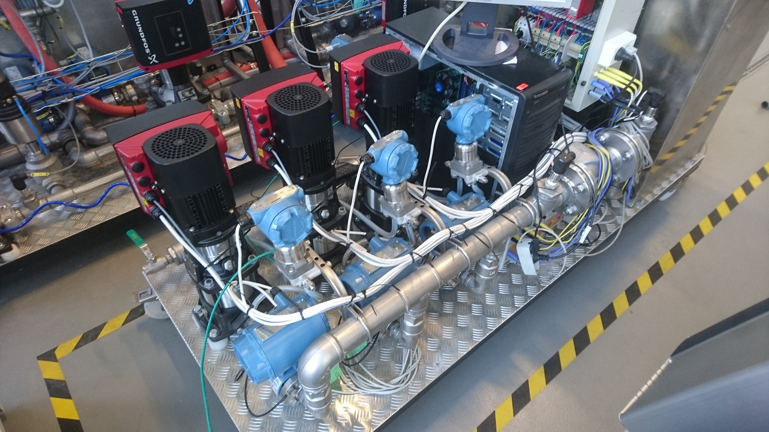
AGENDA
Troels – Physical setup and data
Razvan – Control
Daniel – Future work

Slide 3
INTRODUCTION
Why we chose to work with the pump system?
Working with an already existing system compared to building a system from the ground up.
The end goal was to analyse the pump-system and model it mathematically, in order to be able to keep a constant flow using a PID controller.
Notes:
We chose to work with the pump-system because we thought it would be interesting to work with something that was completely new and challenging.
The 3-pump system was already avaliable to work with, which also was a change from our previous projects were we build everything from scratch. That doesn’t mean it was any easier, because we didn’t know how anything about how it worked and it turned out there was quite a steep learning curve. (just to get to it do anything).
At first we wanted use all three pumps to .. Mention we changed direction due to limited time?? Daniel

Slide 4
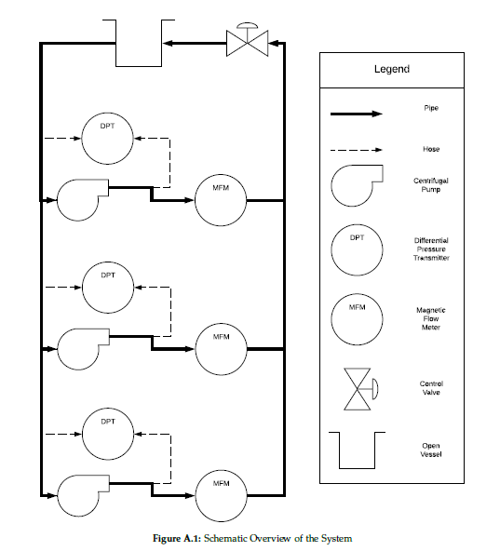
SUMMARY OF THE PHYSICAL SETUP
Explanation of the system’s individual parts
Controlled inputs - Individual pump speed - Control valve
Measured outputs
- Individual flow for each pump - Individual differential pressure for each pump - Individual power consumption for each pump - Pressure over the control valve
Notes:
This could also come first?
The system consists an open 1 water tank
And 3 identical centrifugal pumps, with individual sensors for measuring pressure and flow.
A choke valve that can be operated to change the flow and pressure, or introduce disturbances to the system.
Everything is connected using mainly pipes.

